Slide 1
Discord-GitHub Bot

Slide 2
Project Overview and Objectives
Domain of Interest
1
Our project targets communication within remote software teams using GitHub for code hosting and collaboration. These teams often face challenges due to text-based and asynchronous messaging that can obscure context. We explore integrating AI-driven insights and gamified elements to foster clearer, more engaging exchanges.
Prototype Objective
2
The core objective is to design and develop a prototype AI-gamified communication channel that seamlessly overlays GitHub and Discord interactions. This tool will offer real-time suggestions, rewards and progress indicators to motivate contributors, reduce bottlenecks, and strengthen team cohesion during distributed software projects.

Slide 3
Identifying the Communication Challenge
02
Decreased Engagement
Lack of real-time interaction limits spontaneous discussions, harming team cohesion and identity.
01
03
Text-Based Dependence
Asynchronous Delays
Remote teams rely on text for communication, risking misunderstandings without non-verbal cues.
Time zone differences cause response delays, disrupting collaboration and decision-making.

Slide 4
Prototyping Methodology Explained
Data Sources
Model Development
Gamification Mechanics
Evaluation Methods
User Testing Strategies
We observed interactions from GitHub repositories and Discord chats to train the AI gamification logic.
Utilising NLP, we identified communication patterns and integrated AI suggestions into GitHub-Discord workflows.
Point systems and leaderboards incentivise collaboration milestones, enhancing motivation and team dynamics.
We plan to track metrics like engagement rates and conducted user surveys to refine the gamification elements.
Plan to moderate sessions and workshops provided feedback for usability and engagement, guiding iterative design improvements.

Slide 5
Progress Achievements So Far
Gamification Designs
Usability Testing Feedback
Created featuring points, badges, and leaderboards, receiving positive feedback for their potential to enhance motivation.
02
03
Conducted usability tests revealing timing issues with notifications, leading to refinements for an improved user experience.
User Research Insights
AI Prototype Launch
01
04
Qualitative research with GitHub teams revealed delays, misunderstandings, and low engagement as key communication challenges.
Developed AI communication assistant using Gemini 2.0 model.

Slide 6
Challenges Encountered and Solutions Implemented
A
Asynchronous Delays
Text-based chats caused delays and missed messages. We implemented AI summarisation to highlight crucial updates, speeding responses.
B
Fragmented Context
Disparate discussions hindered project tracking. We used AI to link related threads, consolidating context and simplifying navigation.
C
Low Engagement
Stagnant contributions resulted from a lack of incentives. We introduced gamified rewards and AI-driven recognition to boost participation.
D
Complex Onboarding
New contributors struggled without real-time guidance. AI-assisted tutorials were embedded to help users learn tasks effectively.

Slide 7
Actionable Next Steps
01
Data Analysis
Collect qualitative and quantitative feedback to identify usability issues and enhancement priorities.
Integration Testing
05
Connect the prototype with GitHub and Discord to ensure proper data communication and assess performance under load.
02
Refining the Prototype
Make targeted updates based on data analysis to improve user engagement and ensure an intuitive experience.
Presentation Prep
Compile research, feedback, and visuals for the presentation, focusing on clarity and team roles.
04
User Testing Round 2
03
Engage a diverse group for feedback on gamification and AI aspects to refine usability and motivation.

Slide 8
Feedback and Collaboration Opportunities
Metrics Evaluation
Integration Considerations
Invite input on communication metrics and seek recommendations for additional indicators to enhance the evaluation framework.
Seek advice on the feasibility of integrating the AI-gamified channel with APIs, including potential constraints and risks.
Testing Suggestions
Clarity in Methodology
Gamification Insights
Request ideas for expanding usability testing to include varied workflows and diverse user profiles for broader applicability.
Evaluate if the prototyping methodology is communicated clearly to ensure reproducibility and stakeholder engagement.
Gather feedback on the design of gamification elements to confirm their relevance and motivational effect on remote team roles.

Slide 9
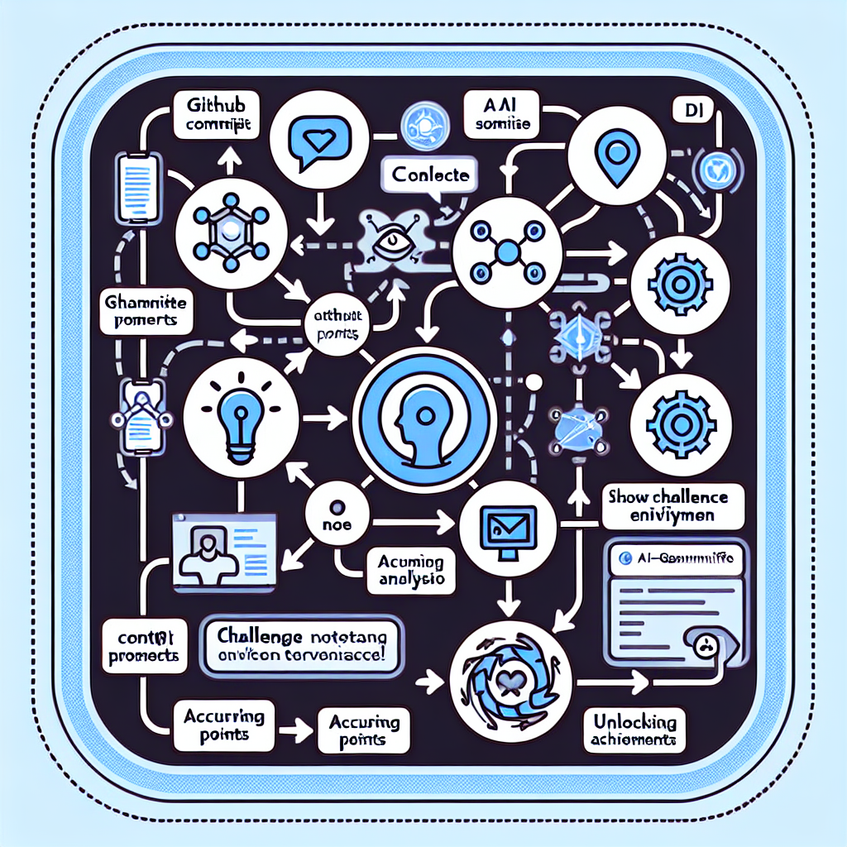
User Journey Overview
This mockup depicts the user journey through the AI-gamified communication channel, starting from a GitHub trigger to AI-driven context analysis within Discord. It emphasises key touchpoints where users receive suggestions, challenges, and feedback loops in real time.
Detailed Interaction Flow
The flowchart highlights sequential steps: a code commit notification on GitHub triggers AI parsing, followed by automated challenge prompts in Discord. Users then interact via comments, earn points for contributions, and progress through levels by completing dependency-resolution tasks.

Slide 10
Anticipated Outcomes and Impact
Issue Resolution Speed
Communication Efficiency
AI suggestions and gamified triage expedite blocker resolution, enhancing sprint velocity and reducing backlog delays.
02
AI summaries and gamified prompts help teams prioritise tasks, reduce overload and enhance consensus speed during reviews.
01
03
Team Cohesion
Engagement and Morale
Peer recognition features and leaderboards cultivate a supportive culture, promoting collaboration and unity in distributed teams.
Gamification with badges boosts developer recognition, fostering achievement and participation, leading to higher morale.
04

Slide 11
Concluding Remarks and Future Directions
Future Development
04
Project Highlights
Future trials will assess collaboration metrics and satisfaction, refining gamification and AI recommendations before broader implementation.
Integrating AI and gamification streamlined communication for remote GitHub teams, reducing cognitive load and increasing engagement.
01
03
Fostering Collaboration
Importance of AI-Gamification
Our approach enhances remote team dynamics, offering scalable solutions for productivity and teamwork across time zones.
02
Game-like incentives and AI recommendations in communication enhance motivation and real-time feedback, addressing messaging latency and social presence.

Slide 12
Thanks for watching
Questions?

